Slide 1
SOLID Principles

Slide 2
Introduction
SOLID principles are an object-oriented approach that are applied to software structure design.
It is conceptualized by Robert C. Martin .
It also ensures that the software is modular, easy to understand, debug, and refactor.

Slide 3
The word SOLID acronym for:
Single Responsibility Principle (SRP)
Open-Closed Principle (OCP)
Liskov Substitution Principle (LSP)
Interface Segregation Principle (ISP)
Dependency Inversion Principle (DIP)

Slide 4
Single Responsibility Principle :
The single responsibility principle states that every class must perform a single functionality.
Implementation of multiple functionalities in a single class mashup the code and if any modification is required may affect the whole class.

Slide 5
Example :
Suppose, Student is a class having three methods namely
printDetails(),
calculatePercentage(),
addStudent()
Hence, the Student class has three responsibilities to print the details of students, calculate percentages, and database. By using the single responsibility principle, we can separate these functionalities into three separate classes to fulfill the goal of the principle.

Slide 6
public class Student
{
public void printDetails();
{
//functionality of the method
}
pubic void calculatePercentage();
{
//functionality of the method
}
public void addStudent();
{
//functionality of the method
}
}

Slide 7
public class Student
{
public void addStudent();
{
//functionality of the method
}
}
public class PrintStudentDetails
{
public void printDetails();
{
//functionality of the method
}
}
public class Percentage
{
public void calculatePercentage();
{
//functionality of the method
}
}

Slide 8
Open/Closed principle :
The open-closed principle states that according to new requirements the module should be open for extension but closed for modification.
The extension allows us to implement new functionality to the module.

Slide 9
//open for extension closed for modification
public abstract class Shape
{
public abstract double Area();
}
public class Rectangle extends Shape
{
public double Width ;
public double Height ;
Rectangle(double w,double h)
{
Width = w;
Height = h;
}
public double Area()
{
return Width*Height;
}
}
public class Circle extends Shape
{
public double Radius ;
Circle(double r)
{
Radius = r;
}
public double Area()
{
return Radius*Radius*Math.PI;
}
}

Slide 10
Liskov Substitution Principle :
“Derived types must be completely substitutable for their base types”.
It states that an object of a superclass should be replaceable by objects of its subclasses without causing issues in the application.
Therefore, a child class should never change the characteristics of its parent class (such as the argument list and return types).
Basically, derived classes should never do less than their base class.

Slide 11
Why is it required to follow Liskov Substitution Principle?
This avoids overuse/misuse of inheritance.
It helps us conform to the “is-a” relationship.

Slide 12
Code that violates LSP
public class BookDelivery {
String titles;
Integer userID;
void getDeliveryLocations() {
...
}
}
public class PosterMapDelivery extends BookDelivery {
void getDeliveryLocations() {
...
}
}
}
//Now, we extend the existing BookDelivery class with an //AudioBookDelivery subclass.
//But, when we want to override the getDeliveryLocations() //method, we realize that audiobooks can’t be delivered to //physical locations.
public class AudioBookDelivery extends BookDelivery {
void getDeliveryLocations() {
/* can't be implemented since
* Audio book doesn't have
* a physical location. */
}

Slide 13
Code that follows LSP
public class BookDelivery {
String title;
Integer userID;
}
public class OfflineDelivery extends BookDelivery {
void getDeliveryLocations() {
...
}
}
public class OnlineDelivery extends BookDelivery {
void getSoftwareOptions() {
...
}
}
public class PosterMapDelivery extends OfflineDelivery {
void getDeliveryLocations() {
...
}
}
public class AudioBookDelivery extends OnlineDelivery {
void getSoftwareOptions() {
...
}
}

Slide 14

Advantages :
Code Re-usability
Easier Maintenance

Slide 15
Interface Segregation Principle :
The principle states that the larger interfaces split into smaller ones.
Because the implementation classes use only the methods that are required.
We should not force the client to use the methods that they do not want to use.
The goal of the interface segregation principle is similar to the single responsibility principle

Slide 16
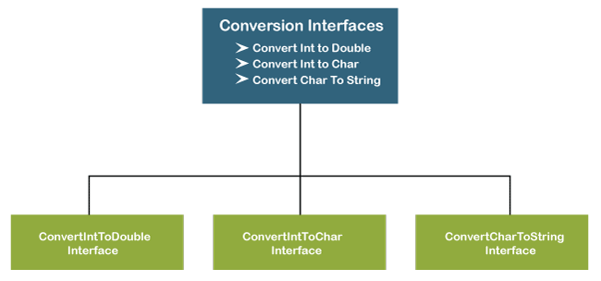

Slide 17
Violates
Follows
public interface ConvertIntToDouble
{
public void intToDouble();
}
public interface ConvertIntToChar
{
public void intToChar();
}
public interface ConvertCharToString
{
public void charToString();
}
public interface Conversion
{
public void intToDouble();
public void intToChar();
public void charToString();
}

Slide 18
Dependency Inversion Principle :
High-level modules should not depend on low-level modules. Both should depend on abstractions.
Abstractions should not depend on details. Details should depend on abstractions.

